Slide 1
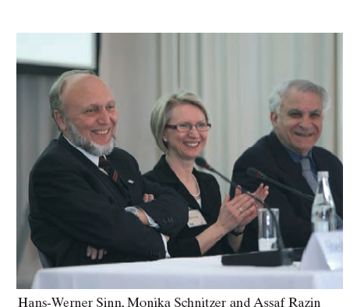
Munich 2008
Hans Werner Sinn’s
60th Birthday

